Slide 1
North Lincs Local Plan Barnetby le Wold
Public Consultation Session
Extraordinary Meeting – Barnetby Parish Council
Wednesday 10 November 2021

Slide 2
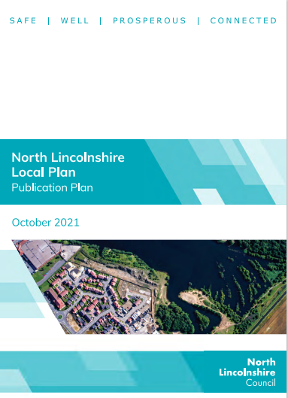
What is a Local Plan?
The Government requires all local councils to develop a long-term plan for their areas, to set out how and where land can be developed over the next 15 to 20 years in order to meet the growing needs of local people and businesses.
The Local Plan sets out what and where development is acceptable and, once agreed and adopted, will govern how planning applications are assessed.
Reference - North Lincolnshire Local Plan (2020 -2038)

Slide 3
What is Happening Now?
North Lincolnshire Council is preparing a new single Local Plan for its area.
It will establish a vision and objectives, allocate sites for housing, employment, retail, leisure, and other forms of development, and will include development management policies up to 2038.
As well as setting out where new development will go, the Plan will also include policies which seek to protect and preserve open space, green infrastructure, the historic environment, and environmental assets. Once adopted, it will update and replace the existing planning policy framework for the area.
A six-week public consultation period is started on Friday 15 October 2021
The final day of public consultation is Friday 26 November 2021.

Slide 4
Stages
Website Link
A New Local Plan | North Lincolnshire Council (northlincs.gov.uk)
Stage 1 - 2017
Stage 2 - 2018
Stage 1: Initial Consultation (Regulation 18)
Stage 2: Issues & Options Consultation (Regulation 18)
Stage 3 - 2020
Stage 4 -2021
Stage 3: Preferred Options Consultation (Regulation 18)
Stage 4: Publication Draft (Regulation 19)

Slide 5
Key Challenges
Health and Wellbeing
Cross Boundary Working
To improve the health outcomes for all of North Lincolnshire’s people by reducing levels of deprivation and ensuring everyone has access to green open space and opportunities for employment, services and to live healthier lives.
To work with our neighbours and partners to deliver the Local Plan
Economic Development
Population Changes
Providing a sufficient supply of employment land, supported by infrastructure provision, in the right locations in North Lincolnshire to support economic growth, including meeting the requirement of our existing and emerging businesses and sectors.
To meet the housing requirements of our growing, and increasingly older population
Housing Provision
Employment
Providing a sufficient supply of housing land and quality houses supported by infrastructure provision, in the right locations in North Lincolnshire to support economic growth, including meeting the needs for all our communities.
To provide increased levels of employment within North Lincolnshire to support economic growth.

Slide 6
Key Challenges
Natural Environment
Protect and enhance our biodiversity and geodiversity sites and wider ecological network that supports them addressing the need for Nature Recovery Networks which allow biodiversity to survive, thrive and move throughout the countryside, building in resilience to impacts from climate change or development and through mandatory biodiversity net gain.
Town Centres
To protect and improve the vitality and viability of our town and district centres, in particular Scunthorpe town centre, in the light of changing shopping, leisure and working patterns, to ensure they remain key hubs for our communities and are more competitive against centres in neighbouring areas.
Visitor Economy
Deprivation
To maximise our current assets and develop new and existing offers to attract visitors to the area, alongside investment in infrastructure and ensuring we protect and enhance the natural environment and those assets that make North Lincolnshire an attractive place to visit.
To reduce deprivation locally and enable communities to flourish.
Education and Skills
Historic Environment
To protect, improve and increase the provision of education and skills in North Lincolnshire, considering changing demographics, and growth patterns, including increasing the number of people with a Level 4 Qualification
Protecting our historic environment and heritage assets for everyone to enjoy now and in the future growth.

Slide 7
Key Challenges
International Connections
Agricultural and Rural Economy
Promote a prosperous rural economy through sustainable business growth, agricultural diversification and rural growth that respects the character of the countryside.
Encourage and support our international connections by ensuring that transport access to our ports and airport is improved and maintained, in order to support increased growth.
Air Quality
Local Transport
To improve air quality in North Lincolnshire generated by heavy industry and traffic and ensure that development is directed away from areas with poor air quality.
Increasing opportunities for the use of sustainable modes of transport including public transport, cycling and walking, to access employment, services and for leisure and recreation, whilst reducing the need to use the private car
Strategic Transport
Digital Connectivity
Increase coverage for FTTP Broadband connectivity within North Lincolnshire and ensuring provision of digital infrastructure and telecommunications to support businesses and residents, taking advantage of new 5G networks and smart technologies economic growth.
Ensuring that our strategic transport network (road, rail and air) is improved to support our ambitions for growth and safer roads and to further develop our regional and national connectivity, working with our partners.

Slide 8
What does this mean for Barnetby Le Wold?

Slide 9
Local Plan – Extracts for Barnetby le Wold
Rail
Large Service Centre
Safeguarded Waste Facilities
A local service links Barton upon Humber with Grimsby, whilst there is also a limited service between Sheffield and Cleethorpes via Kirton in Lindsey, Brigg and Barnetby
The council will continue to work with our partners like Transport for the North, Network Rail and train operators to improve the rail network in our area.
Provide local employment opportunities, and key services and facilities for their surrounding areas, these settlements will be the focus for an appropriate level of growth.
This will be through the provision of allocated sites within this plan, and through non-allocated sites within their defined development limits.
Any development should reflect the character and nature of each settlement, together with infrastructure capacity
Non Hazardous Landfill
Campwood Landfill, Melton Ross Quarries, Barnetby-le-Wold
Household Recycling Centre
Barnetby HWRC, Bigby Road, Barnetby-le-Wold
Biological Treatment
Barnetby-le-Wold Sewerage Treatment Works, Marsh Lane, Barnetby-le-Wold
Inert Waste Transfer/treatment
Melton Ross Quarries, Barnetby-le-Wold

Slide 10
Local Plan – Extracts for Barnetby le Wold
Employment
Large Service Centre
Aviation
A number of other employment allocations such at Barnetby Top and Junction 2 of the M180 have been identified that offer good accessibility to the local highway network.
Provide local employment opportunities, and key services and facilities for their surrounding areas, these settlements will be the focus for an appropriate level of growth.
This will be through the provision of allocated sites within this plan, and through non-allocated sites within their defined development limits.
Any development should reflect the character and nature of each settlement, together with infrastructure capacityThe
Humberside Airport privately owned airfields across North Lincolnshire
These facilities provide a valued contribution to North Lincolnshire’s economy and offer commercial and private flying in a variety of forms.
It is considered that local airfields offering general aviation flying should be protected from development that would have an adverse impact on the running and operation of the airfield, unless it can be demonstrated that the airfield use is no longer viable.

Slide 11
New Dwellings and Development Sites Barnetby Le Wold has been allocated to take on 75 new dwellings by 2038. This is a 1% housing growth increase Barnetby le Wold has also been identified as a development site for employment.
Sites Identified
Top of Kings Road
Land South of Barnetby Interchange

Slide 12
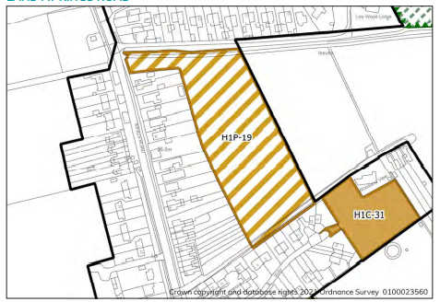
Land at top of King Road – Proposed Development Site
The site is currently available for development and could accommodate approximately 43 dwellings. Affordable housing provision will be expected on site.
A mixture of housing types should be provided, reflecting the findings of the North Lincolnshire Housing and Economic Needs Assessment November 2020 and any future updates.
Housing for Older People – the local plan allocates 20 dwellings within this proposed development site for older peoples housing.
Highway access to the site can be gained from Kings Road. Vehicle access points will need to be agreed by the Local Highways Authority. This site has good access to local services and facilities and is well connected to existing pedestrian, cycle, and public transport routes.
The site is within SFRA Flood Zone 1 and as the site measures more than 1ha a Flood Risk Assessment will be required. This should include consideration of Sustainable Drainage Systems and how the layout and form of development can reduce the overall level of flood risk
Land at Kings Road is an agricultural field located on the edge of Barnetby le Wold.
The site is surrounded by residential properties and agricultural land to the east.

Slide 13
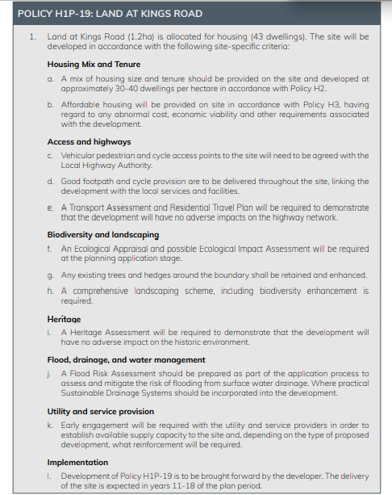
Land at top of King Road – continued

Slide 14
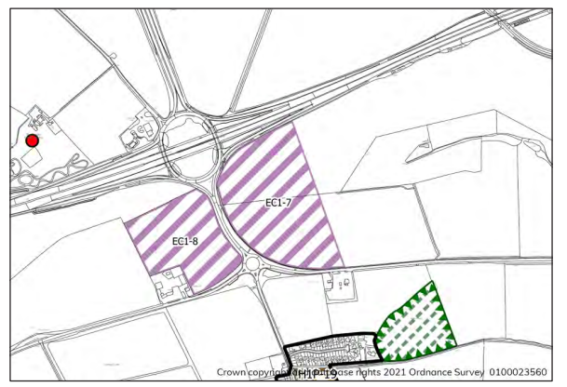
Land South of Barnetby Interchange (West of A18)
The site offers good access to the strategic road network and is located close to the village of Barnetby which offers a railway station and other services. It is considered that the site is ideally located adjacent to the strategic highway network and is suitable for a lorry park and associated services.
Local access improvements to serve Employment Site EC1-6 will be required that include a new junction off the A18 but not directly between Barnetby Top Interchange and the A18 roundabout to the south. These measures will be delivered in a phased manner in accordance with a masterplan accompanying any planning application(s) to be agreed with North Lincolnshire Council.
This area lies within SFRA Flood Zone 1. A Flood Risk Assessment will be required as part of the application process to assess and mitigate the risk of flooding from surface water drainage. Where practical Sustainable Drainage Systems should be incorporated into the development.
To the south of the site there are a number of commercial properties. A comprehensive landscape buffer will need to be provided. that effectively screens the lorry park from the surrounding area including the existing properties to the south located off the A18
The site is comprised of a plot of land immediately south of the Barnetby Top Interchange and west of the A18.
It is agricultural land bounded by Gallows Wood garage and the police storage area to the south west.

Slide 15
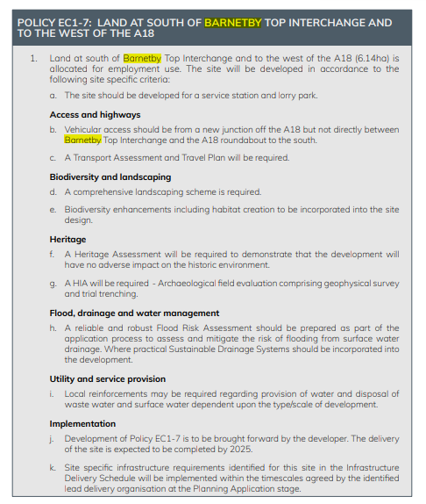
Land at to South of Barnetby Interchange -continued

Slide 16
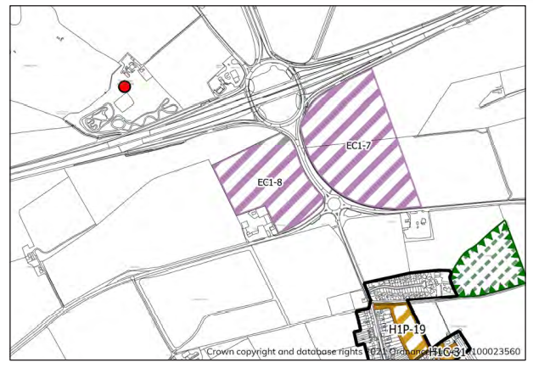
Land South of Barnetby Interchange – (East of A18)
The site offers good access to the strategic road network and is located close to the village of Barnetby which offers a railway station and other services. It is considered that the site is ideally located adjacent to the strategic highway network and is suitable for a business park.
Local access improvements to serve Employment Site EC1-8 will be required that include a new junction off the A18 but not directly between Barnetby Top Interchange and the A18 roundabout to the south. These measures will be delivered in a phased manner in accordance with a masterplan accompanying any planning application(s) to be agreed with North Lincolnshire Council.
This area lies within SFRA Flood Zone 1. A Flood Risk Assessment will be required as part of the application process to assess and mitigate the risk of flooding from surface water drainage. Where practical Sustainable Drainage Systems should be incorporated into the development.
A comprehensive landscape buffer will need to be provided that effectively screens the business from the surrounding area
The site is comprised of a plot of land immediately south of the Barnetby Top Interchange and east of the A18.
It forms part of a larger agricultural field which slopes downwards towards Melton Ross village and has a significant frontage to the A18.

Slide 17
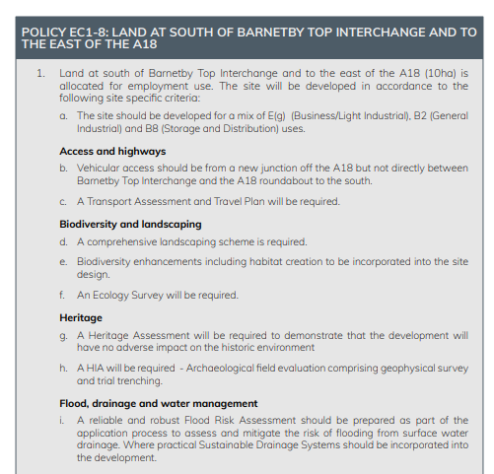
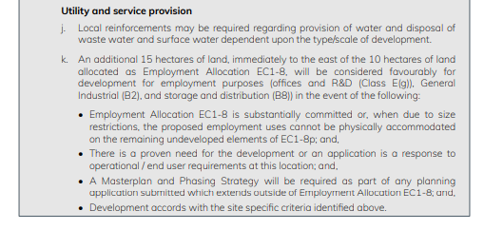
Land South of Barnetby Interchange – (East of A18)

Slide 18
Other Impacts
Public Transport Vision
To start to direct more development away from Scunthorpe towards the other Principal Towns and other large service centres.
Recasting of public transport provision, with a need to maintain focus on supporting Scunthorpe
To better connect the surrounding key settlements, not just with Scunthorpe but also with each other.
The need to improve bus service provision to plug the gaps in the rail network.
Notably, to provide an improved direct link between Barton and Brigg via Barnetby linking identified housing and employment sites.
Short term subsidy is likely to be required for such a service but longer term, with the support of other policies in this Plan and the LTP ITS, a commercial and sustainable operation should be achievable.

Slide 19
Other Impacts
Melton Ross Bridge
This structure carries the A18 over the South Humber Mainline (rail), linking Humberside Airport to the M180 at Barnetby Top.
The bridge is currently in a weakened state and the only long-term practical solution is the provision of a new structure.
This will ensure that this section of the A18 remains open to all vehicles and maintains unimpeded linkages between the

Slide 20
Goals for Q1
Employee opportunities
Online – Here to Help | North Lincolnshire Local Plan (northlincs.gov.uk)
Remaining Public Consultation Sessions

Slide 21
Thank you for your time

